Slide 1
Overview of the Philippines’ National Review for HLPF 2016
DIRECTOR ERLINDA M. CAPONES
National Economic and Development Authority
Trade Union Network Meeting on 2030 Agenda
6 April 2016
Bangkok, Thailand

Slide 2
Outline
Philippine Priorities on the SDGs
Planned Strategies in Mainstreaming SDGs
Emerging Challenges
National Efforts towards SDGs Mainstreaming and Implementation
Possible Areas of Collaboration

Slide 3
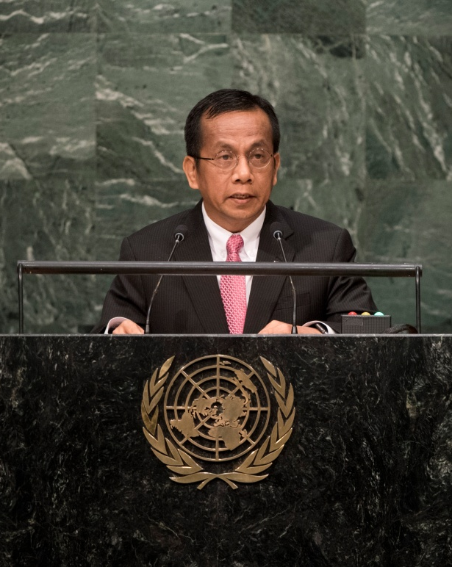
Philippine Priorities on the SDGs
“Make the 2030 Agenda a reality and leave no one behind.”
The Philippines called for:
Recognition of migrant rights;
Addressing climate change with urgency;
Collective action for conservation;
Equality of opportunities
Notes:
Last September 2015, the Philippines joined UN member states in support of the adoption of the Sustainable Development Goals (SDGs) and pushed for urgent action to combat climate change and its impact.
The Philippines pledged “to make the 2030 Agenda a reality and leave no one behind.” We welcomed the inclusion of Philippine priorities in the 2030 Agenda namely, the recognition of the rights of migrants; to need to address climate change with urgency; the need for collective action for conservation; and equality of opportunities.

Slide 4
National Efforts on SDGs Mainstreaming and Implementation
Building Awareness
National-level
Mainstreaming
SDGs Indicators Development
Review of Existing Institutional Mechanisms
Notes:
Responding to the SDGs challenge, the Philippine government initiated parallel/simultaneous efforts on the development of national-level indicators, building awareness through briefings, and reviewing the functions of existing institutional arrangements which we have utilized on the implementation of the MDGs.

Slide 5
National Efforts on SDGs Mainstreaming and Implementation
Indicator Development
Multi-Sectoral Workshop on SDGs indicators (22 October 2015)
a.) Examined relevance of the initial list of SDG indicators to the Philippines’ development objectives;
b.) Identified indicators which are not included in the UN list but are deemed to be relevant/crucial in achieving the SDG targets;
c.) Assessed whether data on the SDG indicators identified are available from existing data sources or at least can be made available; and
d.) Prioritized from the list the set of indicators that should be part of the core indicators to be monitored in the Philippines.
Notes:
Our initial step towards establishing a mechanism for monitoring the SDGs is through the conduct of a multisectoral technical workshop on the SDGs indicators held last October 22, 2015 spearheaded by NEDA and the Philippine Statistics Authority.
293 participants from various national government agencies, civil society, UN Country Team, and the academe attended the workshop. Salient features of the 2030 Agenda and ways forward on SDGs implementation were discussed.
The participants examined the relevance of the initial list of proposed SDGs indicators; identified indicators which were not in the list but deemed to be relevant and crucial in achieving the SDGs targets; assessed whether the data are available from existing data sources or at least can be made available; and prioritized which should be part of the core indicators to be monitored in the Philippines.
In view of the global indicator framework agreed by 47th Session of the UN Statistical Commission, a second round of workshops/consultations will be conducted to finalize the core national-level indicators.

Slide 6
National Efforts on SDGs Mainstreaming and Implementation
Indicator Development
TARGET DATE | ACTIVITY
April 2016 | Philippine Statistics Authority (PSA) and NEDA Workshop
May 2016 | Multisectoral Technical Workshop on SDGs Indicators
May – June 2016 | Consultation with Inter-agency Committees/Technical Committees and Source Agencies
July 2016 | Initial list of SDGs Indicators for National Monitoring
July 11-20 | High-level Political Forum
August 2016 | Coordination with Data Sources and Identification of SDG Focal Points
July – November 2016 | Formulation of metadata
October – November 2016 | Consultation with relevant IAC/TC on metadata
December 2016 | Finalization of list of SDG indicators and metadata
Notes:
The Philippine Statistics Authority will be working on this timeframe.
April 2016 – PSA and NEDA will conduct a technical workshop to coincide the global indicators with the initial list of identified national-level indicators
May 2016 – as mentioned, the Multisectoral Technical Workshop on SDGs indicators will be conducted
From May to June, consultations with Inter-agency and technical committees will be undertaken
July 2016, release of the initial list of national SDGs indicators
August 2016 – coordination with data source agencies and identification of SDG focal points
July – November – formulation of metadata
October - November – consultations with the IACs/TCs on metadata
December – target date to finalize the list of the national SDGs indicators and metadata

Slide 7
National Efforts on SDGs Mainstreaming and Implementation
Building Awareness
Briefings on the SDGs
NATIONAL GOVERNMENT AGENCIES
Department of Health
Department of Environment and Natural Resources
National Anti-Poverty Commission
National Council on Disability Affairs
Department of Education
Department of the Interior and Local Government
Commission on Population
Union of Local Authorities in the Philippines
5th Monitoring and Evaluation Network Forum
ACADEME
University of the Philippines Los Baños
University of Santo Tomas
De La Salle University
Notes:
In terms of building awareness and to sensitize stakeholders on the SDGs, briefings on the SDGs have been conducted for the following national government agencies and universities. Updates on the probability of meeting the MDGs, lessons learned on MDG implementation, salient features of the 2030 Agenda, and the planned strategies to achieve the SDGs were presented.

Slide 8
National Efforts on SDGs Mainstreaming and Implementation
Building Awareness
Briefings on the SDGs
NON-GOVERNMENTAL ORGANIZATIONS
Philippine Business for Environment’s Annual General Meeting (private sector)
Foundation for the Philippine Environment ‘s Regional Consultative Meetings (civil society, peoples organizations, local communities)
2016 Philippine League of Local Environment and Natural Resources Officers, Inc. (PLLENRO) National Convention (Local Environment and Natural Resources Officers)
12th CBMS Philippines National Conference (Local Government Units)
Notes:
Briefings were also conducted for the following non-government organizations.

Slide 9
National Efforts on SDGs Mainstreaming and Implementation
Review and Update of Institutional Arrangements
SOCIAL
Social Development Committee
Multi-sectoral Committee on International Human Development Commitments
ENVIRONMENTAL
Philippine Council for Sustainable Development
ECONOMIC
Cabinet Cluster on Economic Development
Cabinet Cluster on Human Development and Poverty Reduction
Cabinet Cluster on Climate Change Adaptation and Mitigation
* House of Representatives – Special Committee on the MDGs
Notes:
We have already established coordination and monitoring bodies for the MDGs. Given the wider scope of the SDGs, these will be enhanced and strengthened.
The Cabinet Cluster on Human Development and Poverty Reduction focuses on improving the overall quality of life of the Filipino and translating the gains of good governance into direct, immediate and substantial benefits that will empower the poor and marginalized segments of society.
The Social Development Committee (SDC) advises the President and the NEDA Board on matters concerning social development, including education, manpower, health and nutrition, population and family planning, housing, human settlements, and the delivery of other social services. It coordinates the activities of government agencies concerned with social development; and recommends appropriate policies, programs and projects consistent with the national development objectives.
For program and project coordination, the Multisectoral Committee on International Development Commitments (MC-IHDC) is being utilized to monitor the country’s progress and the efforts of various stakeholders to promote achievement of the MDGs. The MC-IHDC is a subcommittee of the NEDA Board’s SDC and was created to monitor, report, review, and evaluate the Philippine compliance to commitments made during international conferences on human/social development.
The Cabinet Cluster on Climate Change Adaptation and Mitigation focuses on the conservation and protection of the environment and natural resources. It takes the lead in pursuing measures to adapt and mitigate the effects of climate change and undertakes all the necessary preparation for both natural and man-made disasters.
The Philippine Council for Sustainable Development (PCSD) formulates policies and recommends new actions to appropriate bodies on Sustainable Development issues focusing on the environment dimensions of social and economic interventions; review and monitor plans, policies, program and legislation on SD; reviews and ensures the implementation of the commitments made by the Philippines in the light of the United Nations Conference on Environment and Development (UNCED) and its follow-up process.
The Cabinet Cluster on Economic Development focuses on the promotion of rapid, inclusive and sustained economic growth.
In implementing the MDGs, there is explicit support from the legislative branch. The House of Representatives (HOR) created the Special Committee on the MDGs functioning as an oversight body of HOR in attaining the MDGs. The Committee’s mandate includes the following: (a) ensure the passage of MDG-supportive bills; (b) study and assess the effectiveness of MDG-supportive laws; (c) institute a progress review of the MDG policy agenda every eighteen (18) months; and (d) ensure budget allocation in the annual General Appropriations Act (GAA) for MDG-supportive programs. We foresee that Congress will again create a Special Committee on the SDGs.
With all these existing mechanisms helping to coordinate and monitor the implementation of the SDGs, we plan to create a high-level committee consisting of Ministers and Parliamentarians to ensure the achievement of the SDGs.

Slide 10
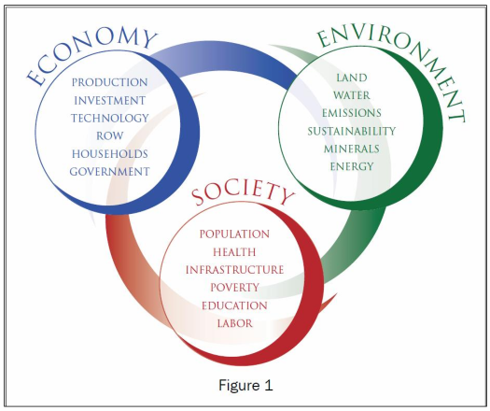
Planned Strategies in Mainstreaming SDGs
Political Commitment
NEDA is leading the formulation of a long-term vision - Filipino 2040
As part of the Filipino 2040, the Threshold 21 (T21) model, developed by the Millennium Institute-Washington, will be utilized to ensure that the long-term vision will facilitate the achievement of sustainable development.
Notes:
POLITICAL COMMITMENT
The NEDA is leading the formulation of a long-term vision - Filipino 2040 - which aims to define the Philippines 25 years from today.
As part of the Filipino 2040, the Threshold 21 (T21) model, developed by the Millennium Institute-Washington, will be utilized to ensure that the long-term vision will facilitate the achievement of sustainable development.
The model is a dynamic simulation tool designed to support long-term national development planning. It integrates into a single framework the economic, the social, and environmental spheres, including linkages and feedbacks, that can better inform policymakers.
The T21 model contains 18 sectors, 6 sectors for each sphere and expandable based on country needs. The current version currently contains some SDG-related indicators, but can be further customized once the national-level indicators has been finalized.
T21 supports comparative analysis of different scenarios, and helps users identify the set of policies that leads towards a desired goal (e.g., SDG outcomes).

Slide 11
Planned Strategies in Mainstreaming SDGs
Political Commitment
Integrate the SDGs in the next Philippine Development Plan and Public Investment Program
Engage LGUs and communities for localized SDG implementation
Monitoring and Reporting Mechanisms
Constitute a dedicated oversight committee with technical secretariat
Generate and disseminate timely disaggregated SDG data: SDG Chapter in Philippine Statistical Development Program; SDG Webpage and SDG Watch; SDG Focal Points within concerned agencies
Notes:
POLITICAL COMMITMENT
To ensure their inclusion in our national development discourse, we will integrate the SDGs in the next Philippine Development Plan and Public Investment Program.
Given their impact on the achievement of our national objectives, we will also ensure localization of the SDGs and get the Local Government Units and communities on board. This strategy will help us address spatial and sectoral concerns.
MONITORING AND REPORTING MECHANISMS
We would also be strengthening our implementation and monitoring system for the SDGs. First, oversight will be provided by a high-level committee chaired by NEDA. Second, to ensure that SDG data – and budget for collecting said data – we included a chapter on the SDGs in the Philippine Statistical Development Program. Third, a webpage on the SDGs will be created wherein the SDG Watch – a compendium of SDG-related data – will be provided. And fourth, each concerned agency will have an SDG Focal point to facilitate coordination of SDG-related policies and data.

Slide 12
Emerging Challenges
Natural and man-made shocks
Need for intensive localization
Data constraints
Insufficient timely and reliable data
Demand for disaggregated data
Financing for the SDGs
Notes:
First, the influx and scale of natural and man-made shocks remains a challenge. According to the UN Asia-Pacific Disaster Report of 2015, the Philippines placed second among 15 countries that had the highest risk from natural disasters and placed third among 15 countries that have the highest exposure to natural disasters. Natural and man-made shocks can stagnate growth and push the non-poor into poverty and poor people into deeper poverty, undermining development efforts.
Second, as a decentralized form of government, local government units are at the forefront of planning, resource allocation, and implementation of policies and programs to reduce poverty. Cognizant of the importance of a strong local action and leadership, we need to further engage LGUs, build their awareness and capacities to develop evidence-based policies and programs.
Third, the 2030 Agenda calls for increased support in strengthening data collection and capacity building in all Member States, taking into consideration the gap in data collection and the unavailability of baseline data for some of the targets. Furthermore, as the 2030 Agenda pledges that no one will be left behind, there is also a demand for official statistics to be more disaggregated, frequent, timely, and accessible.
Fourth, the financing requirement of the 2030 Agenda will continue to be crucial such that both public and private resources need to be tapped. The support and commitment of development partners and the private sector will also be very important to implement and achieve the country’s SDGs and targets. Further, the adequacy and development impact of Official Development Assistance (ODA) in the context of the 2030 Agenda is vital given the special needs and vulnerability of developing countries. There is a need to accelerate ODA to ensure additional financial resources to address development challenges of countries and support their implementation and achievement of the SDGs. Also, access to adequate long-term financing for disaster risk reduction and management are crucial for vulnerable countries such as the Philippines to cope and adapt from these development challenges.

Slide 13
Possible Areas of Collaboration
Technology transfer
Facilitate technology transfer, knowledge sharing and sustained cooperation
Technical assistance on data revolution
Improve data collection, dissemination, and analysis
Enhance absorptive capacities of local institutions
Increase technical know-how and involvement of local institutions
Disaster risk reduction management
Notes:
Increasing transfer of and access to technology. The identified early movers, specifically technologically-advanced countries with their resources, should develop the appropriate technologies within the reach of developing countries to facilitate technology transfer, knowledge sharing and sustained cooperation towards transition to greener and cleaner production and deliver SDGs-related commitments.
Technical and financial assistance on data revolution. It is recognized that one of the critical challenges in SDGs implementation in developing countries is limited data availability for more informed decision-making. The Philippines deems it necessary to improve data collection, dissemination and analysis and provide a foundation for the identification of clear and measurable SDG indicators and appropriate strategies and interventions at the national and local levels to address development challenges. Moreover, disaggregated data are needed to ensure that no one is left behind.
Building absorptive capacities of local institutions. It is important to strengthen efforts to ensure that local institutions are well-equipped to deliver SDGs commitments through increasing their technical-know-how and involvement in the entire development process. It is necessary to guarantee that the human and financial resources are in place at the local level.
Disaster risk reduction management. Also, access to adequate long-term financing for disaster risk reduction and management are crucial for vulnerable countries such as the Philippines to cope and adapt from these development challenges.

Slide 14
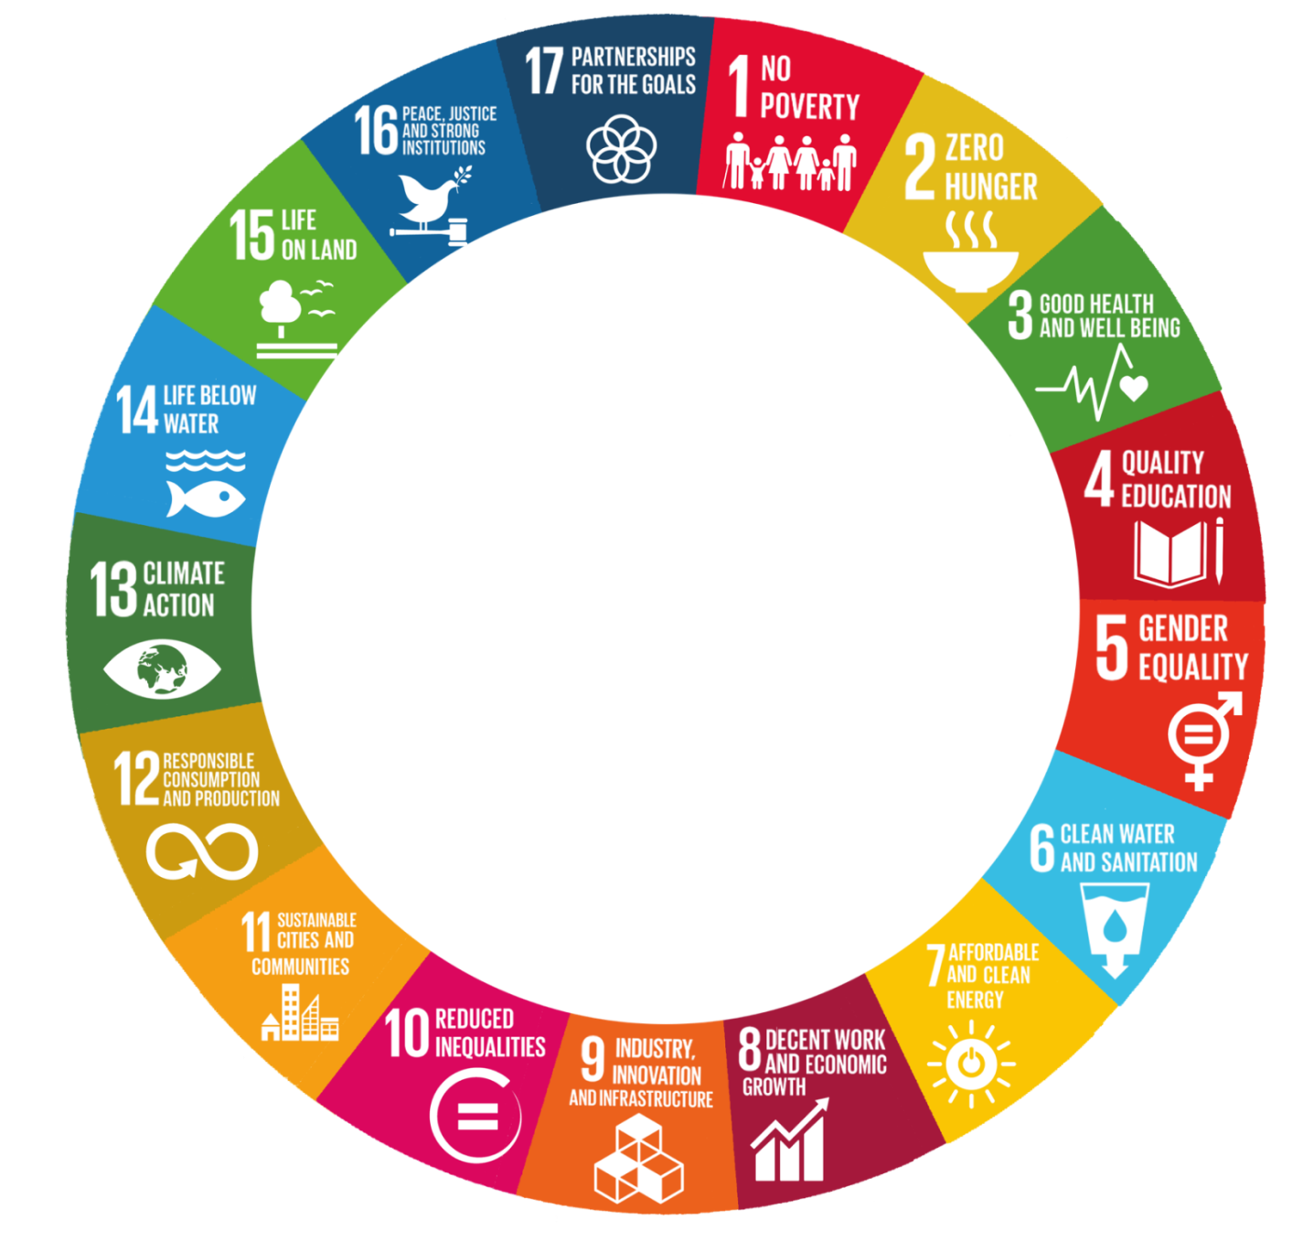
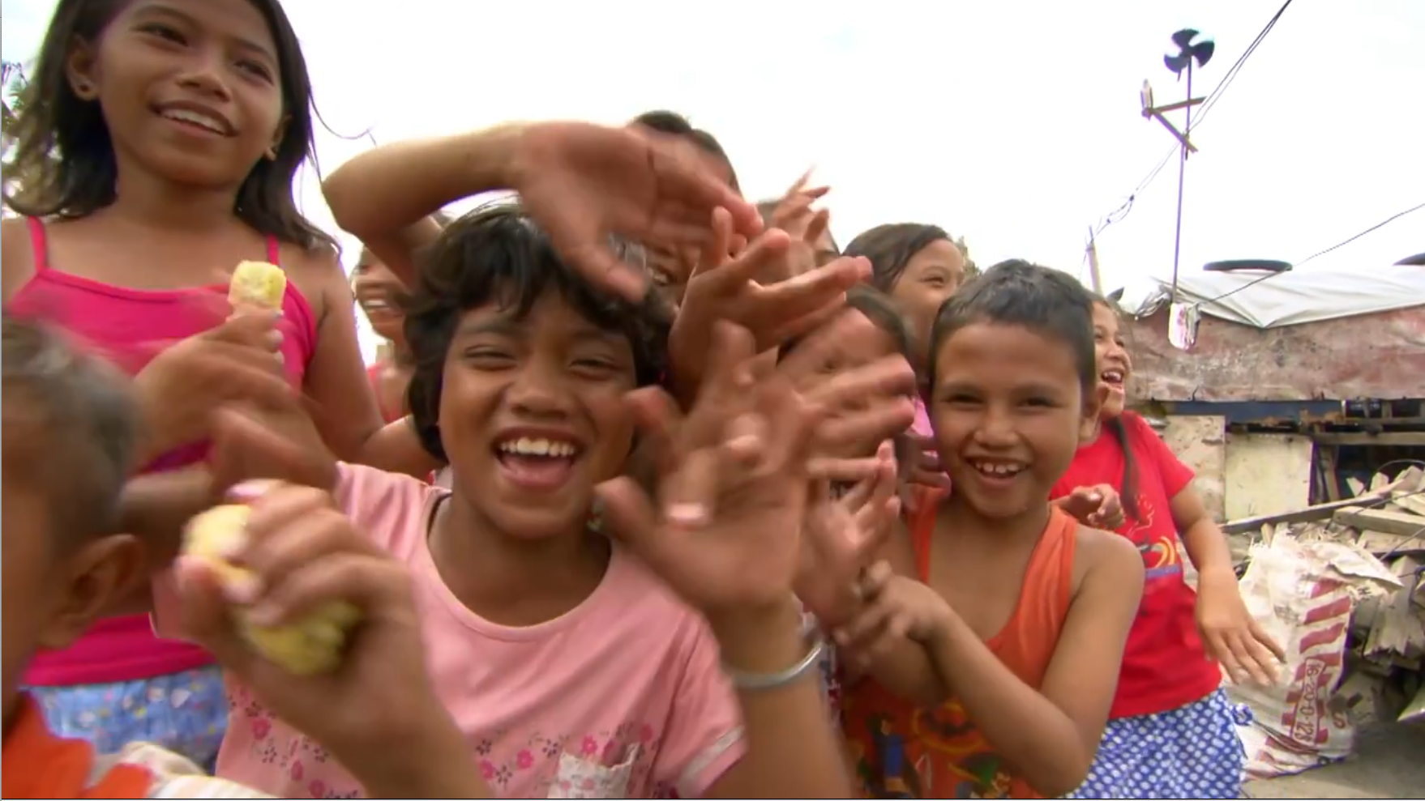
Leave
No
Filipino
Behind
Notes:
That ends my presentation. Thank you!

