Slide 1
TRADE UNION-OECD DAC FORUM
The private sector contribution to the SDGs and the “impact imperative” in financing sustainable development
Haje Schütte, Senior Counsellor and Head of Division, Financing for Sustainable Development Division, OECD Development Co-operation Directorate

Slide 2
AGENDA
Financing for Sustainable Development: Time to face the challenge
Blended Finance as a way to mobilise additional capital
The impact imperative for Financing Sustainable Development

Slide 3
Time to face the challenge

Slide 4
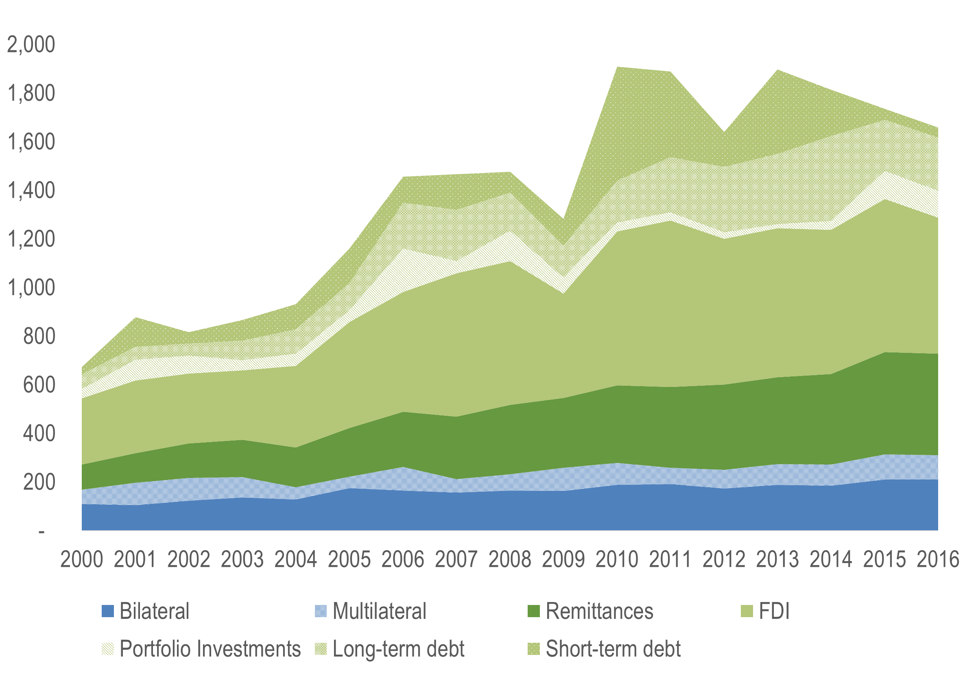
The trillions are in the system…
Remittances by migrants reached a record high of USD 466 billion in 2017
Official development assistance is steady at USD 146.6 billion in 2017
Philanthropy contributes an average of USD 7.9 billion a year over 2013-2015
Government revenues remain below the 15% of GDP threshold necessary for effective state functioning
FDI dropped by 30% over 2016-17 to USD 750 billion
Source: 2019 Global Outlook on Financing for Sustainable Development
… but are not going where most needed.

Slide 5




3 major paradigm shifts are needed
A new approach to “shift the trillions” is required to align broader actors and resources in support of sustainable development
Data: better measurement for greater FSD impact
Regulation: better policies for a more transparent and efficient FSD market
Co-ordination: better solutions to implement holistic FSD approaches

Slide 6
MOBILISING ADDITIONAL FINANCE

Slide 7
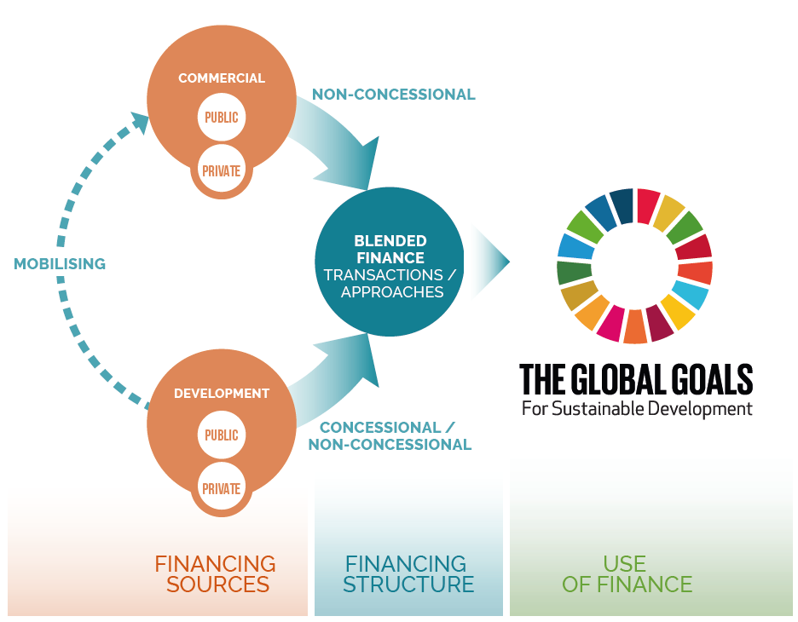
Mobilising Additional Finance
Blended finance is the strategic use of development finance for the mobilisation of additional finance towards sustainable development in developing countries.
Source: 2018 Making Blended Finance Work for the Sustainable Development Goals

Slide 8
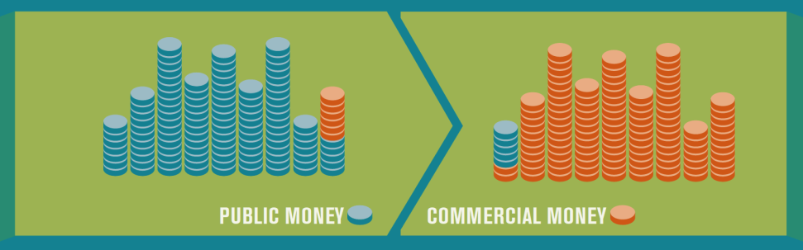
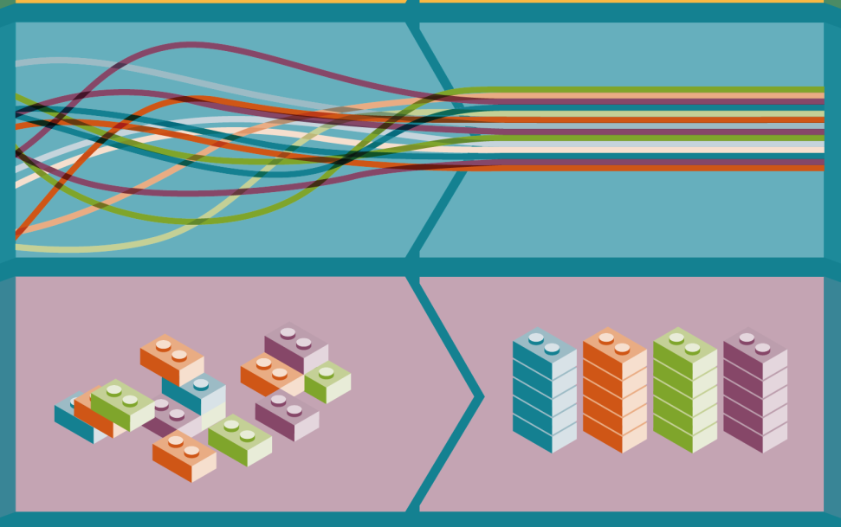
Moving towards Blended Finance 2.0
From blending today
to Blended Finance 2.0
Combining different sources of public development finance
Attracting commercial
finance
Wide variation in understanding of blending, lack of policy coherence and standards
Common framework and understanding of blending supporting cohesive action
Consistent estimates of blended finance market, assessment of effectiveness of blended finance
Lack of evidence and data on blended finance
Source: 2018 Making Blended Finance Work for the Sustainable Development Goals

Slide 9
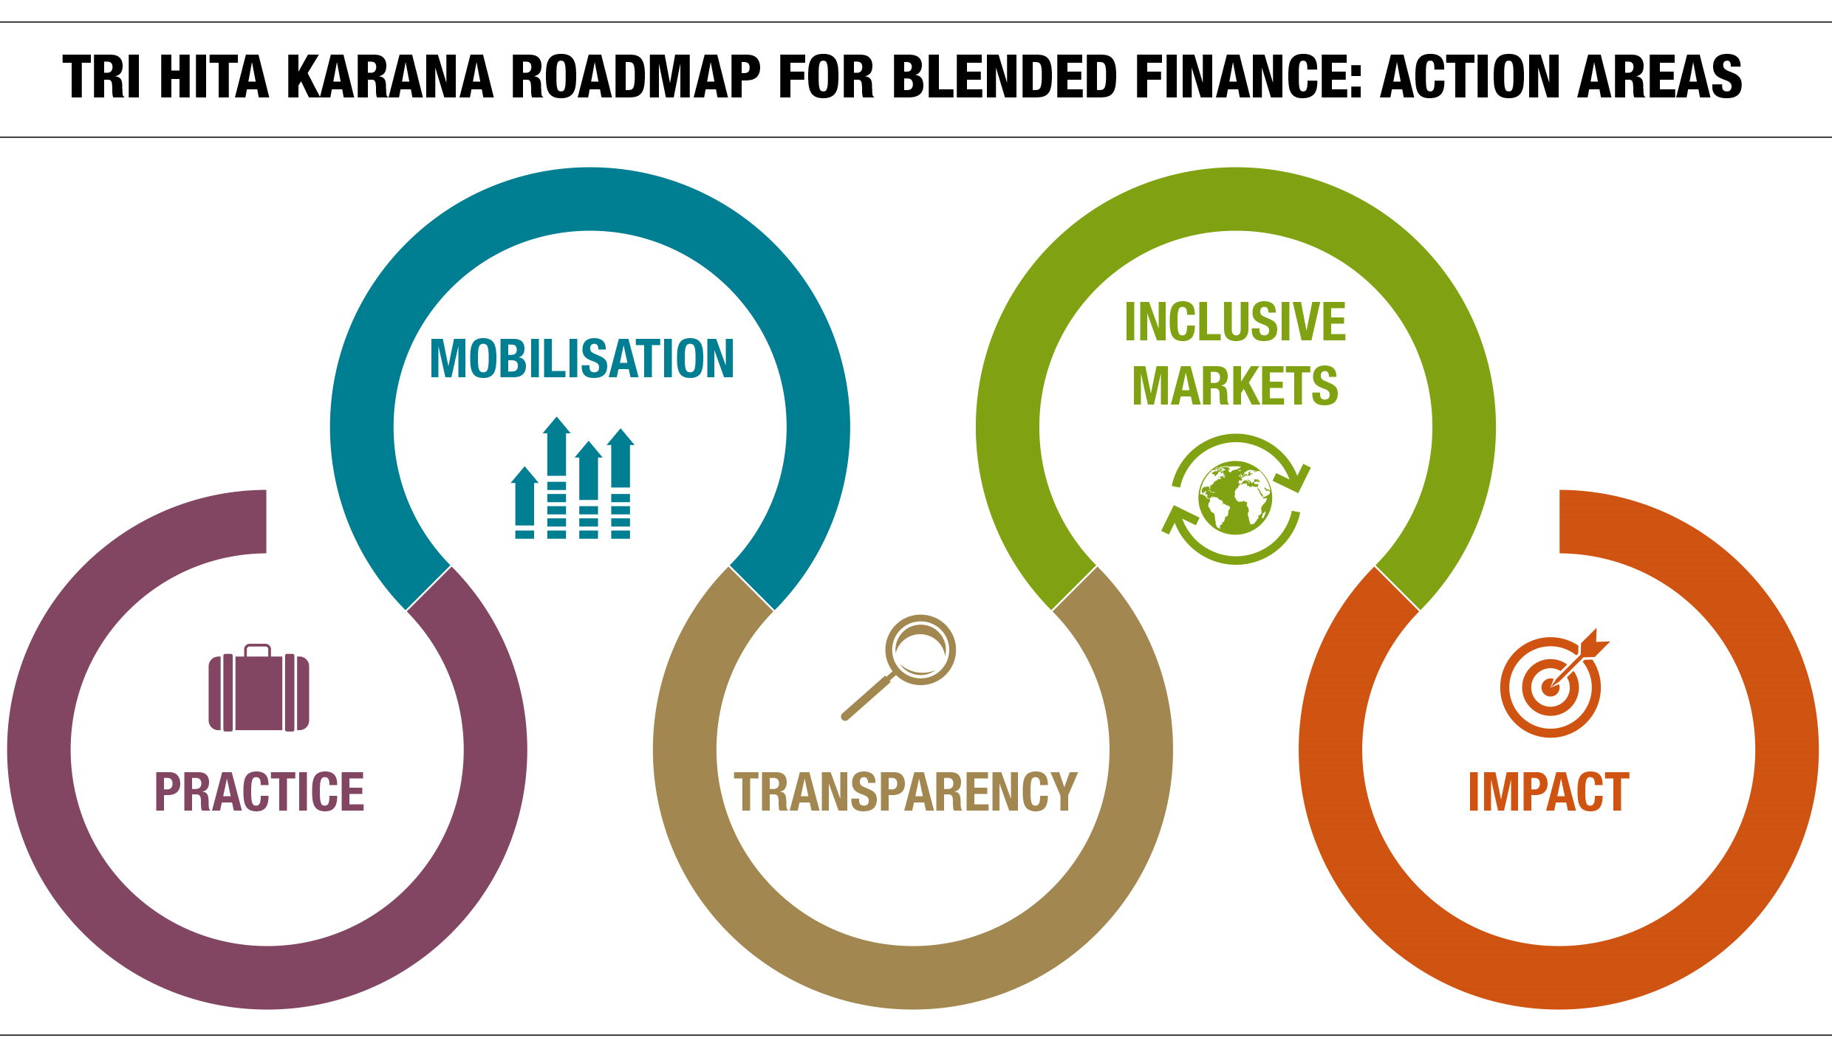





Multi-stakeholder Effort to Scale Blended Finance

Slide 10
THE IMPACT IMPERATIVE

Slide 11
Social Impact Investment
The global market is rapidly growing
The risk of “impact washing” is compounded by:
diverse definitions of impact investing
the lack of internationally comparable data
underdeveloped impact measurement practices

Slide 12
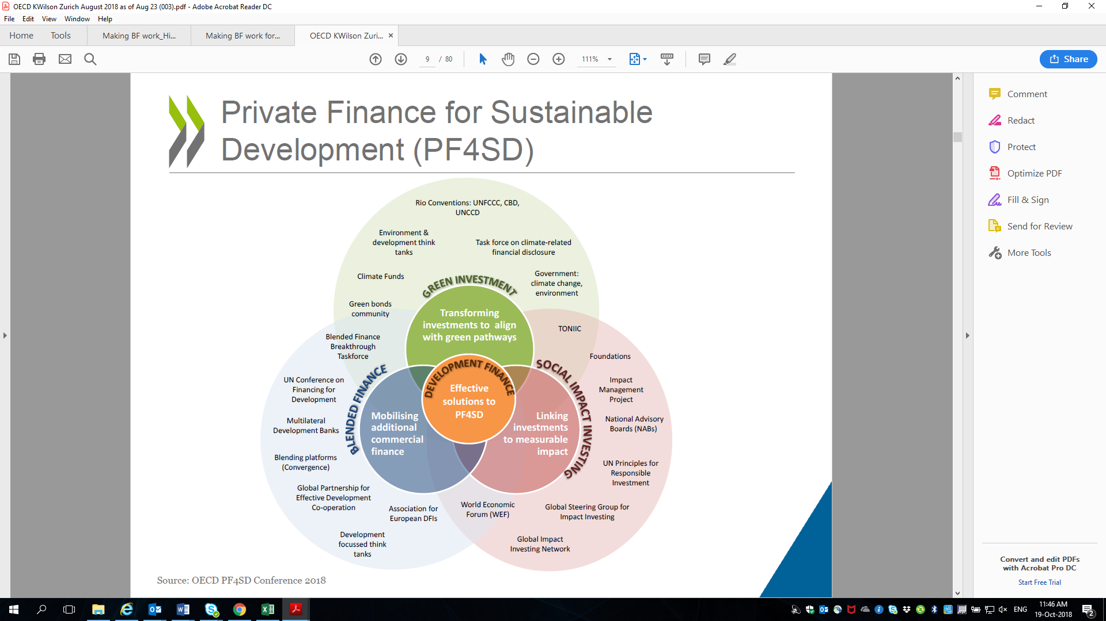
The Financing for Sustainable Development Landscape
Source: OECD 2018

Slide 13
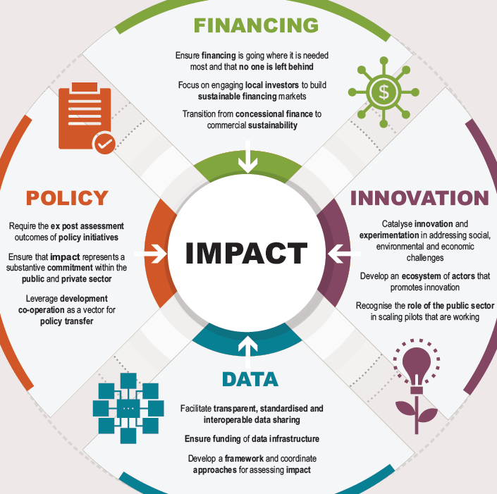
The Impact Imperative for Financing Sustainable Development
Source: Social Impact Investment 2019: The Impact Imperative for Sustainable Development

Slide 14
Thank you

Slide 15
ANNEX

Slide 16
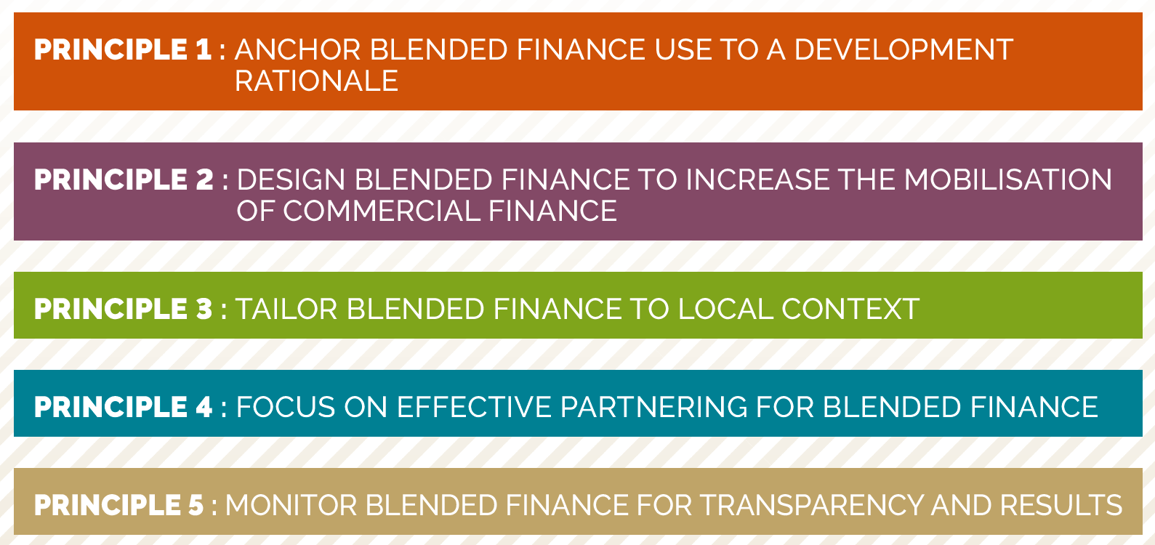
OECD Blended Finance Principles

